Slide 1

Sentiment Analysis for British Airways Reviews

Slide 2
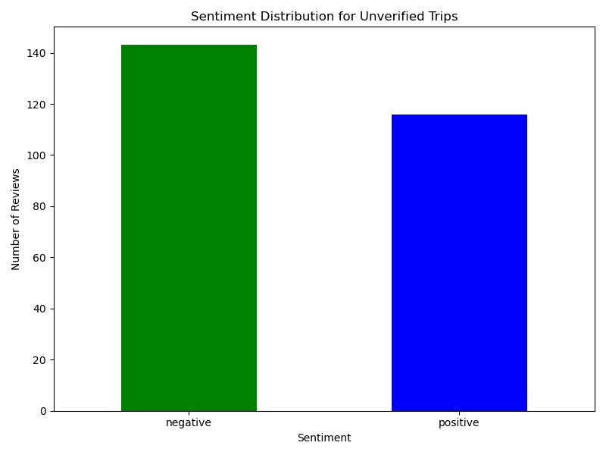
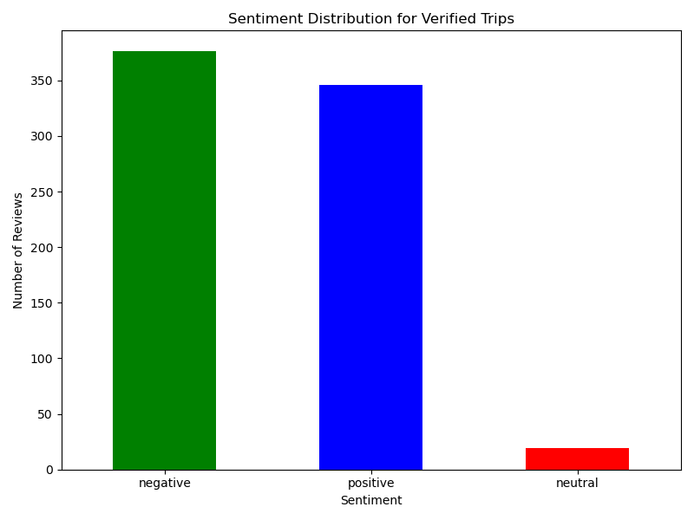
A total of 1,000 customer reviews were analyzed, with 741 attributed to verified trips. The sentiment analysis revealed that 519 reviews (52%) were negative, 462 (46%) were positive, and only 19 (2%) were neutral. Verified trips showed a slightly higher proportion of negative sentiments (376 reviews) compared to positive ones (346), while unverified trips followed a similar trend with 143 negative and 116 positive reviews. This indicates potential customer dissatisfaction across both verified and unverified trips. It is recommended that British Airways focus on addressing recurring issues identified in negative feedback, particularly in verified reviews, to enhance customer satisfaction and improve their service reputation.
Analysis | Not Verified | Verified | Sentiment Total
Negative | 143 | 376 | 519
Neutral | 0 | 19 | 19
Positive | 116 | 346 | 462
Review Total | 259 | 741 | 1000

